Slide 1
Virtual Academy
Gauttam Sonkamble
Vaishali Kalbhor

Slide 2
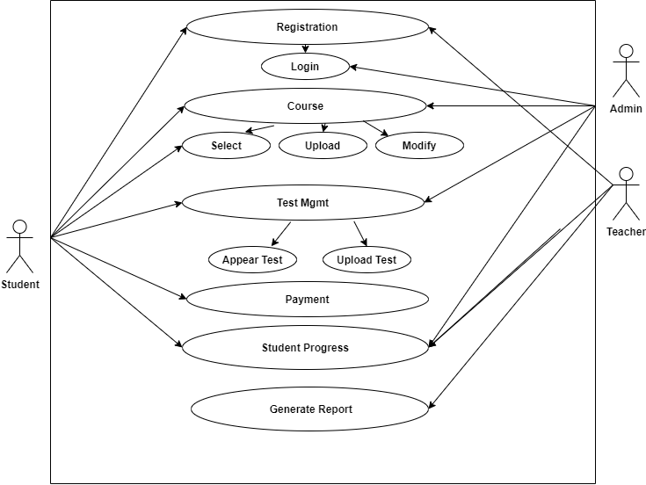
Use Case Diagram

Slide 3
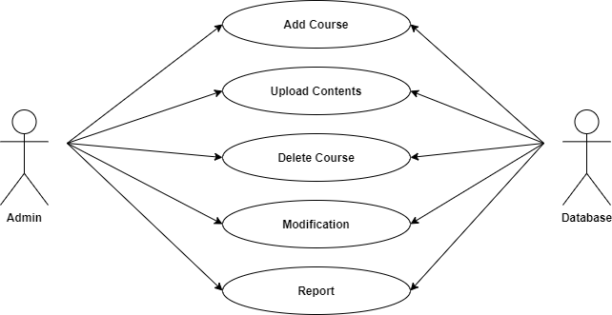
Use Case Diagram
Admin:

Slide 4
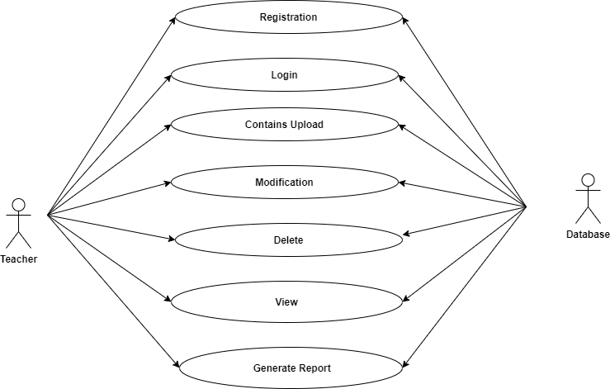
Teacher:

Slide 5
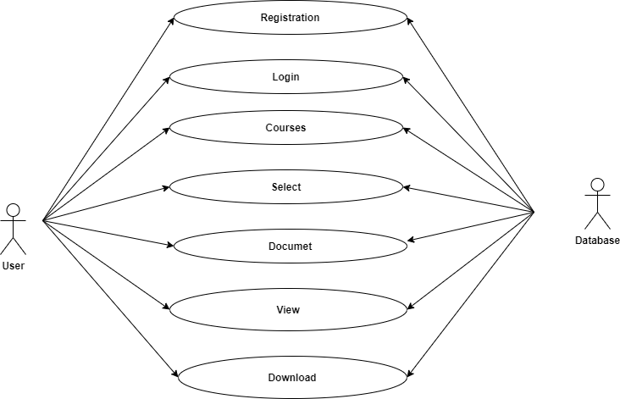
User:

Slide 6
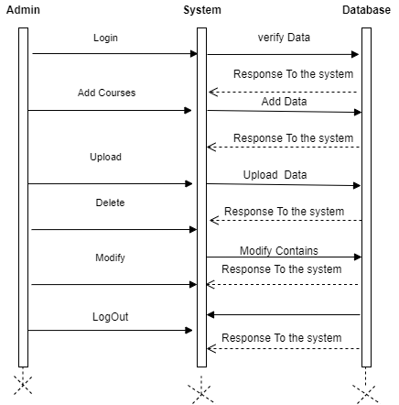
Sequence Diagram
Admin:

Slide 7
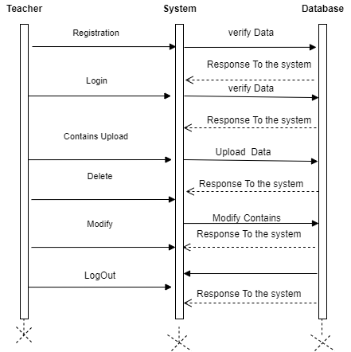
Teacher:

Slide 8
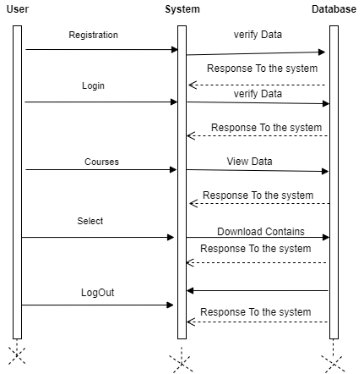
User:

Slide 9
Activity Diagram
Admin:

Slide 10
Teacher:
Upload contents

Slide 11
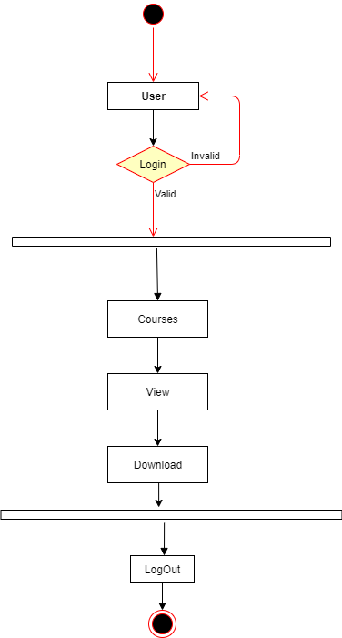
User:

Slide 12
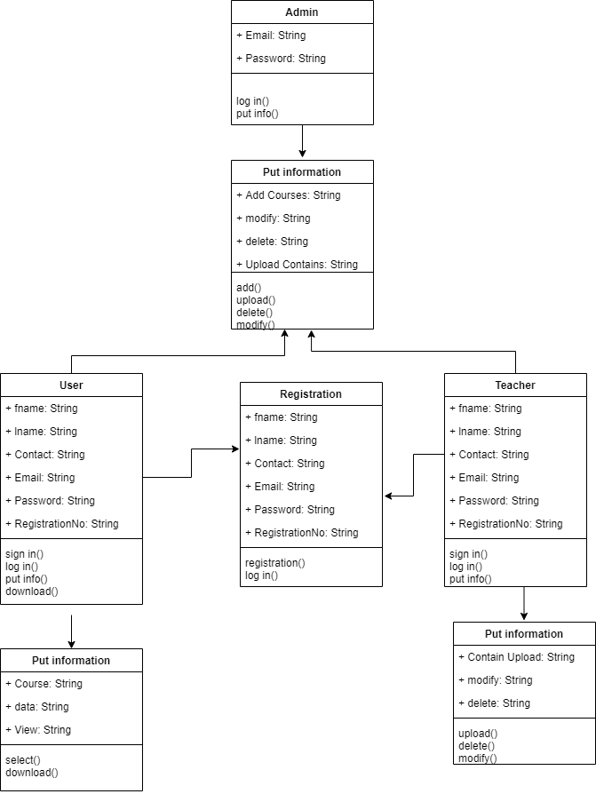
Class Diagram:

Slide 13
THANK You

